Slide 1
CYCLISTIC BIKE SHARE ANALYSIS 🚴
Project Done by Ajith Kumar Ganesan

Slide 2
PROBLEM STATEMENT:
Design marketing strategies aimed at converting Cyclistic’s casual riders into annual members.
SUMMARY:
Designed Interactive dashboard with a given data using TABLEAU visualisation tool and also used some Main Components of Rides Per Day, Rides Per Week & Ride type, Total Trip Duration by Week & Bike type and Trip Duration by Weekday & Weekend data are performed.
BUSINESS TASK:
Analyze historical bike trip data to identify trends in how annual members and casual riders use Cyclistic bikes differently.

Slide 3
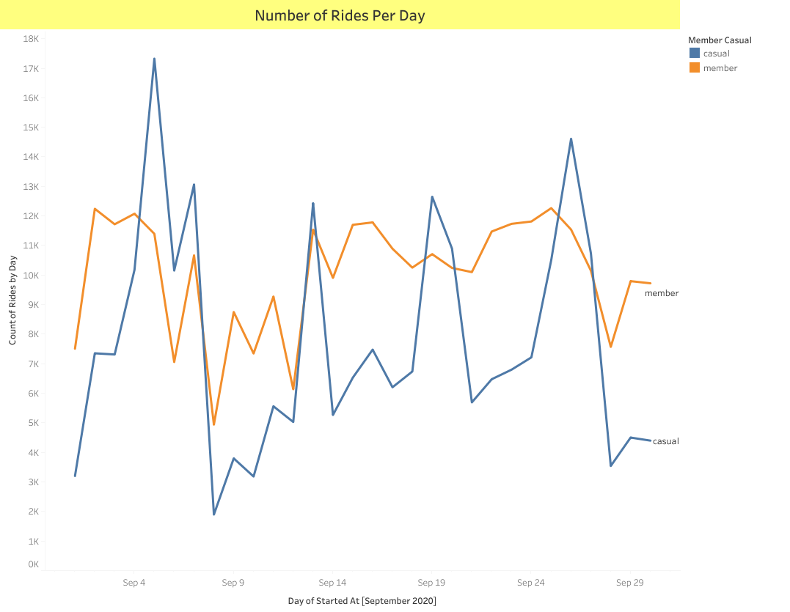

Slide 4
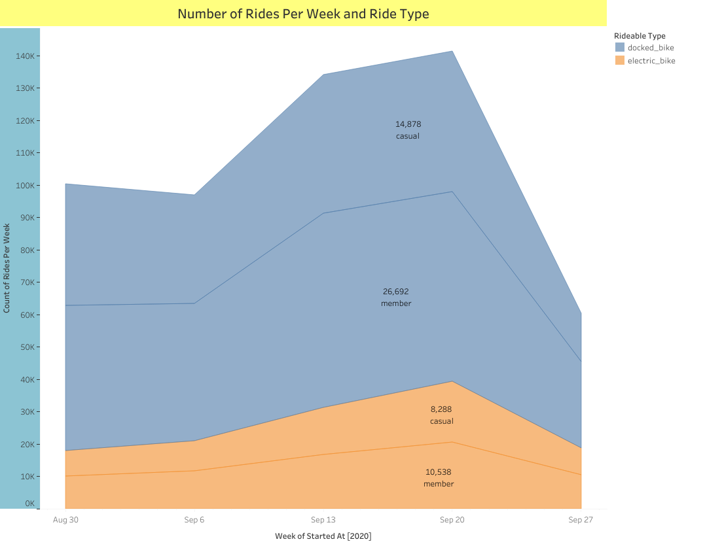

Slide 5
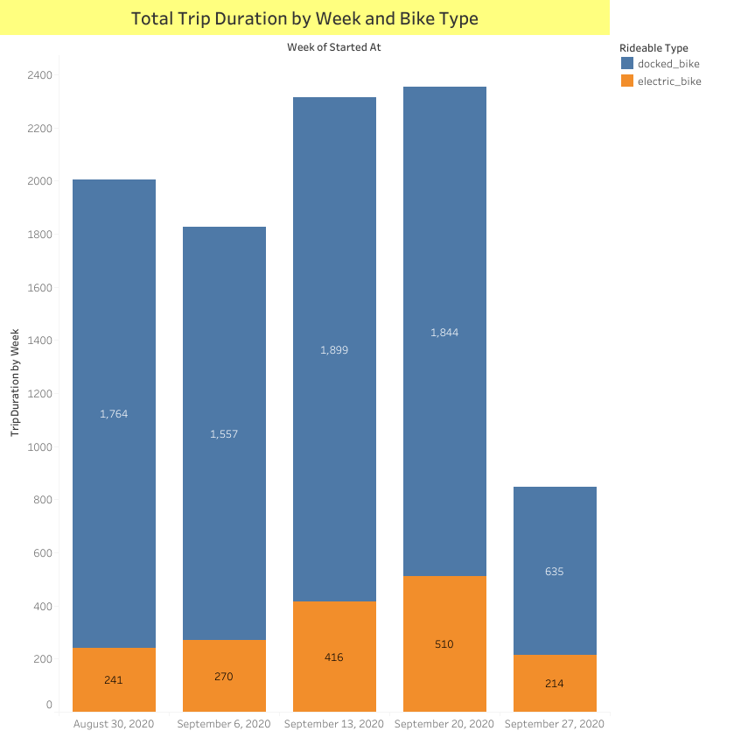

Slide 6
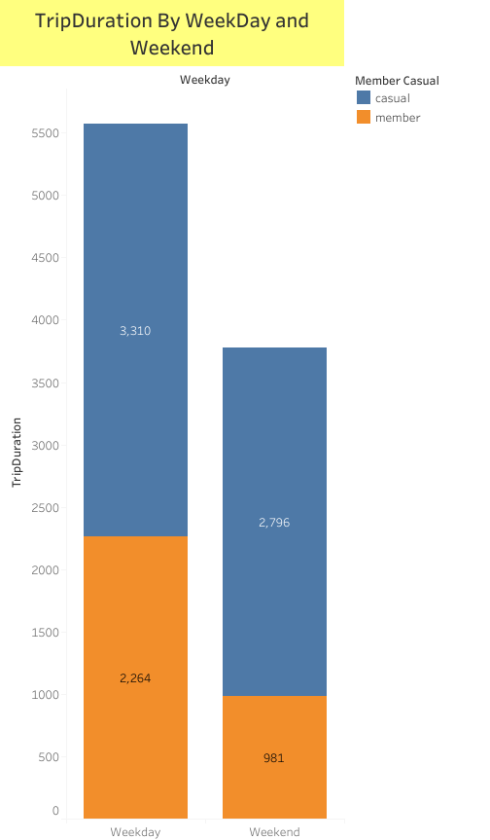

Slide 7
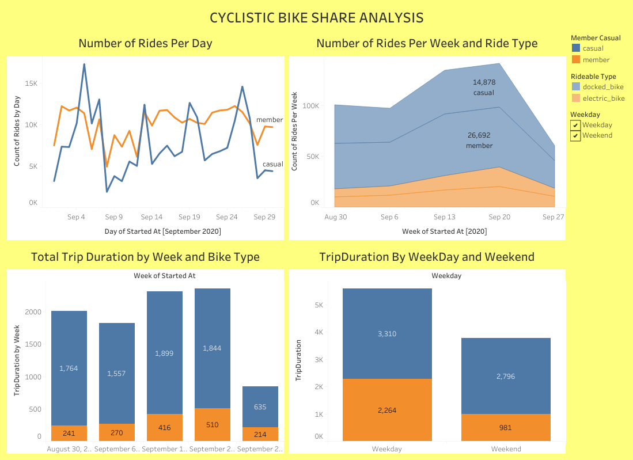

Slide 8
CONCLUSION:
INSIGHTS
Cyclistic has more subscribed annual members than casual riders
Casual riders use the bikes for longer periods of time compared to annual members
Casual riders use the bikes heavily during the midweek (Tuesdays, Wednesdays) while Annual Members use the bikes more from Thursday to the weekends.
The Docked Bike ride type has much less annual riders using it compared to casual riders that use it more.
RECOMMENDATIONS
Since majority of casual riders use the bikes during the week, our marketing strategies should target casual riders that use the bikes for commutes to work.
A discount should be placed on the docked bikes to entice more riders to use it and entice our casual riders to subscribe to our annual plans.

